Slide 1
Section 5.3
Integration: “Integration by Substitution”

Slide 2
All graphics are attributed to:
Calculus,10/E by Howard Anton, Irl Bivens, and Stephen Davis Copyright © 2009 by John Wiley & Sons, Inc. All rights reserved.

Slide 3
Introduction
In this section we will study a technique called substitution. It can often be used to transform complicated integration problems into simpler ones.
This method is directly related to the chain rule that we learned in chapter three for taking the derivative of a composition of functions f(g(x)).

Slide 4
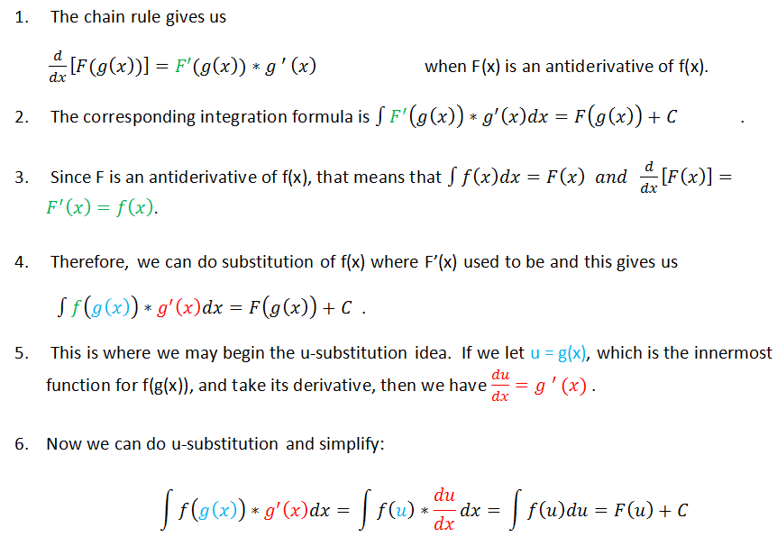
Relationship to the Chain Rule

Slide 6
Example
I picked x²+1 to be u because it is the “innermost function” and its derivative du/dx=2x which is also in the original problem and will make substitution easier.

Slide 7
Rules for Choosing u
There is no rule for how to pick u that works 100% of the time.
If you are starting with a composition of functions f(g(x)), setting u=g(x) will almost always work and that is a good thing to look for.
Another strategy that often works well is to look for two parts of the original question where one part is the derivative of another. Make one du/dx and the other equal to u.

Slide 8
Example of f(g(x))

Slide 9
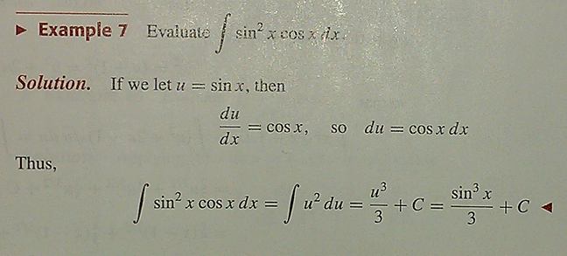
Example when a function and its derivative are both in the question:
The derivative of sin x is cos x and this original question has both. That often signals that we should make u = sin x and du/dx = cos x to make substitution work.

Slide 10
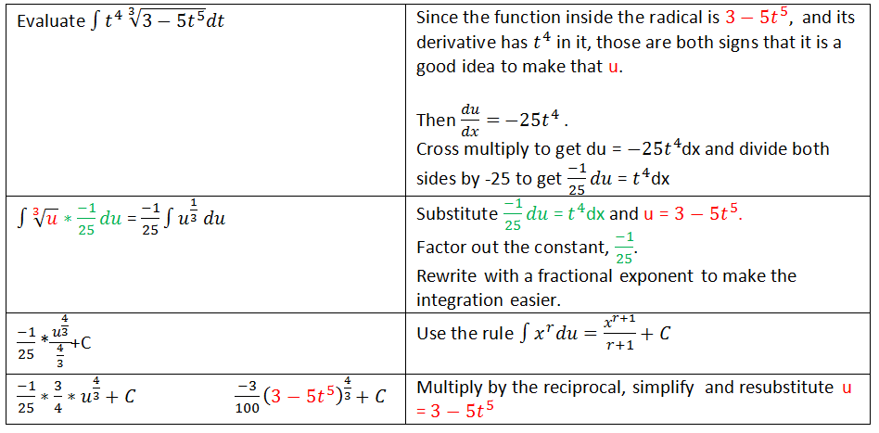
Another example
Keep practicing and you will get better at these.
Since 3-5t5 is inside the radical, it is a good choice for u.

Slide 11
The Duomo – Florence, Italy
I love the pink and green and
the intricacy of the work.

